Slide 1


Far Western University
BLOCK-GAMES
Presented by
Guided by
Er . Birendra Singh Dhami
Anuradha Bhatta (3)
Dipa Joshi (12)
Dipak Raj Giri (13)
Menuka Paneru (25)
Faculty of Engineering
07-2022

Slide 2
CONTENT
Abstract
Introduction
Methodology
Literature review
Results
Conclusion
BLOCK-GAMES
07-2022
2

Slide 3
ABSTRACT
Block-game is a computer action game.
It provides an intelligent board to response to the actions by user.
The board provides features like,
1.attractive representation using different colors.
2.automatic completion of block detection.
3.automatic score calculation.
4.provides a classic board where you can play like in paper.
To achieve this we have used C++ with graphics.h and fstream.h headers.
BLOCK-GAMES
3
07-2022

Slide 4
INTRODUCTION
Block-game is a modified digital version of dots-and-boxes game
This game was invented by French Mathematician Edward Lucas in 1891, who called it pipopipette.
Dots and Boxes is a two player (sometimes more) game that using paper and pencil.
Block-game provides two types of boards , advanced board and
classic board.
User can choose any board using mouse or touch screen as an input
devices.
BLOCK-GAMES
07-2022
4

Slide 5
PROBLEM STATEMENT
Both the players can choose any line (except the line already chosen) on their respective turn.
A box should be completed when the its four sides are selected.
The point should be given to the player who makes the complete box and when any player makes a box he will get a bonus chance too.
The respective representative symbol should be printed when a player completes a box.
BLOCK-GAMES
5
07-2022

Slide 6
OBJECTIVE
To make this game playable in computer or tablet.
To make the game easy to play.
To make the game look attractive.
To make this game with some operations automated.
To show the concepts of OOP, C++ and how it is used in real world problems.
BLOCK-GAMES
6
07-2022

Slide 7
APPLICATIONS
For entertainment by kids sometimes youths too.
To study concepts of OOP and C++.
To create games similar to it having some additional things.
BLOCK-GAMES
7
07-2022

Slide 8
FEATURES
This game provides two types of boards , advanced and classic.
The advance board automatically detects the completion of block.
The game is able to show live points of both player and turn of the player.
This game itself counts the points of each players and declares winner itself.
This game provides classic board to feel the classic game.
BLOCK-GAMES
8
07-2022

Slide 9
FEASIBILITY ANALYSIS
Economic Feasibility
To make this game we needed an PC with normal requirement so we don’t need any funds for the hardware.
To make this game we needed the software which are free.
For the research purpose all the data and information is available in google or internet so no investment to hire an researcher.
This game will be available for everyone on the GitHub with source code for study purpose.
BLOCK-GAMES
9
07-2022

Slide 10
FEASIBILITY ANALYSIS
Technical Feasibility
Since this game is made with C++ , it is platform independent.
The executable file of this game is build for windows so this executable is dependent on Windows OS.
This game can be played on PC/Laptop/Tablet with windows OS , for other OS we have to use that source code to build the respective executable for that OS.
BLOCK-GAMES
10
07-2022

Slide 11
REQUIRMENTS
Hardware Requirement
PC/Laptop/Tablet
Processor: 1.4 Ghz,32 bit or more
Ram: 512MB or more
HDD or SSD: compatible with processor
Display: (700 x 750) Capable video adapter and monitor
Mouse or Touch screen
Software Requirement
Operating system: windows 7, windows 10, windows 8, windows_xp
Compiler tdm_gcc 32 bit (included graphics .h)
IDE : CodeBlocks , VsCode ,
dev-C++,turbo-C++ etc.
BLOCK-GAMES
11
07-2022

Slide 12
METHODOLOGY
This game is made with C++.
It uses concept of classes and objects so it divides the game into small pieces using classes and functions.
To represent the sides we make the objects of classes and give them some functions to operate on this.
File handling is used in about and the help section.
Graphics is used for showing the output which is a predefined library.
BLOCK-GAMES
12
07-2022

Slide 13
Methodology
Main
1.Advanced Game
2.Help
3.About
4.Classic
BLOCK-GAMES
07-2022
13

Slide 14
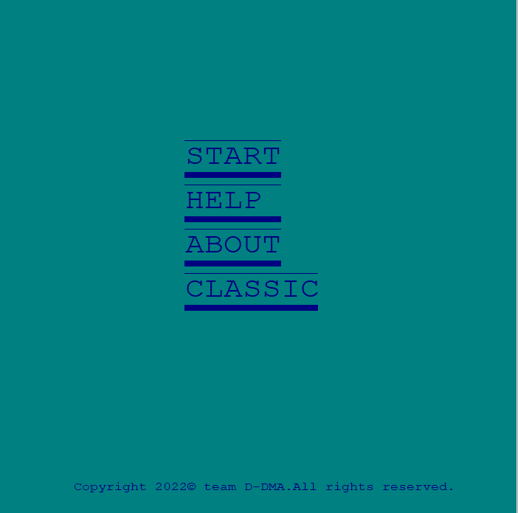
Methodology
Method start()
Takes the click position
Returns value according to click
For start-1,help-2,about-3,classic-4
Method main()
Using the methods start() and control statements it invokes the respective function
BLOCK-GAMES
07-2022
14

Slide 15
Methodology
Graphics Library Functions
initwindow() , setbkcolor()
rectangle(args) , circle(args)
setcolor() , setfillstyle() , floodfill()
outtextxy() ,settextcolor(), readimagefile()
BLOCK-GAMES
15
07-2022

Slide 16
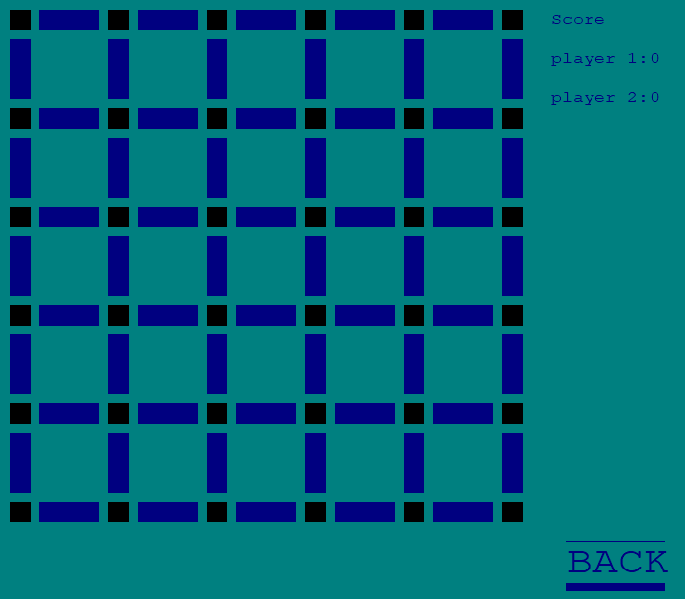
Advanced Game
Click Action
POINT cursorpos;
GetCursorPos(&cursorpos);
x = cursorpos.x;
y = cursorpos.y;
GetAsyncKeyState(VK_LBUTTON)
BLOCK-GAMES
07-2022
16

Slide 17
Advanced Game
Class recth
Variables to store the attributes of horizontal sides
Functions to draw rectangles and change the color
Method Square
Draws squares on the board.
Method Board
It uses the classes and function defined earlier
Uesd to show the board
Inheritance
Class rectv
Variables to store the attributes of verticle sides
Functions to draw rectangles and change the color
Method backbutton
creates backbutton
BLOCK-GAMES
07-2022
17

Slide 18
Advanced Game
Method getnumber
It provides the number of the side according to the mouse clicked
Method Game
Starts the game using methods board , getnumber , backbutton , hcheckbox ,
vcheckbox
Contains variables to store the players turn,players scores
Contains the logic of winning of player i.e game end
Method hcheckbox
It tells how many number of blocks are made when the side is selected
Method vcheckbox
It tells how many number of blocks are made when the side is selected
BLOCK-GAMES
07-2022
18

Slide 19
Help
This section uses File handling and the methos defined earlier.
File gamerule
This file includes the game rules which is included in the game folder
Method help
It defines an object of ifstream class
to read the required information from file
The data after reading from file prints that information to screen
BLOCK-GAMES
07-2022
19

Slide 20
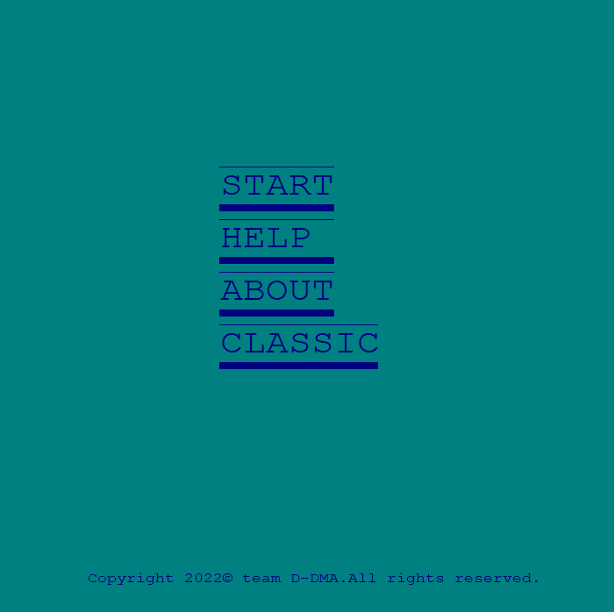
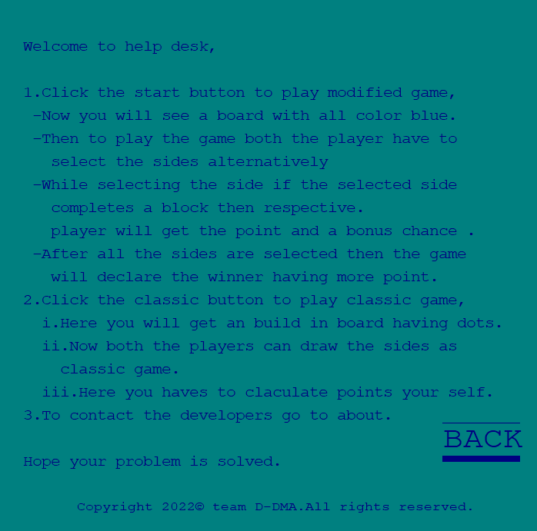

Help
BLOCK-GAMES
07-2022
20

Slide 21
About
This section uses File handling and the methos defined earlier.
File about
This file includes the includes the information about game which is included in the game folder
Method help
It defines an object of ifstream class
to read the required information from file
The data after reading from file prints that information to screen
BLOCK-GAMES
07-2022
21

Slide 22

About
BLOCK-GAMES
07-2022
22

Slide 23
Classic
Class recth
Variables to store the attributes of horizontal sides
Functions to draw rectangles and change the color
Method classic
Provides a board using methods square() , backbutton() , draw(),delay().
it allows user to draw line like pen using mouse(while(1)).
The line is made up of many numbers of circles from the class circle.
Inheritance
Class classcircle
Variables to store the attributes of circles sides
Functions to draw circles
BLOCK-GAMES
07-2022
23

Slide 24
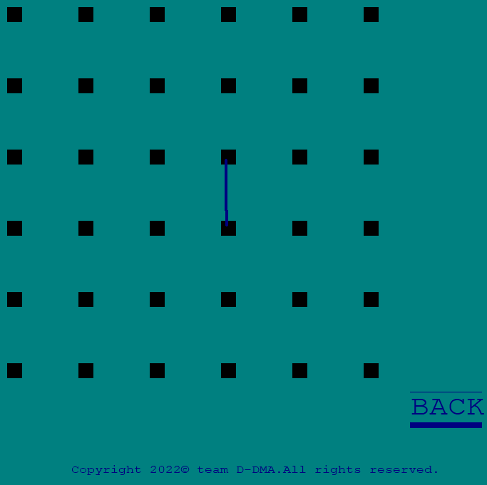
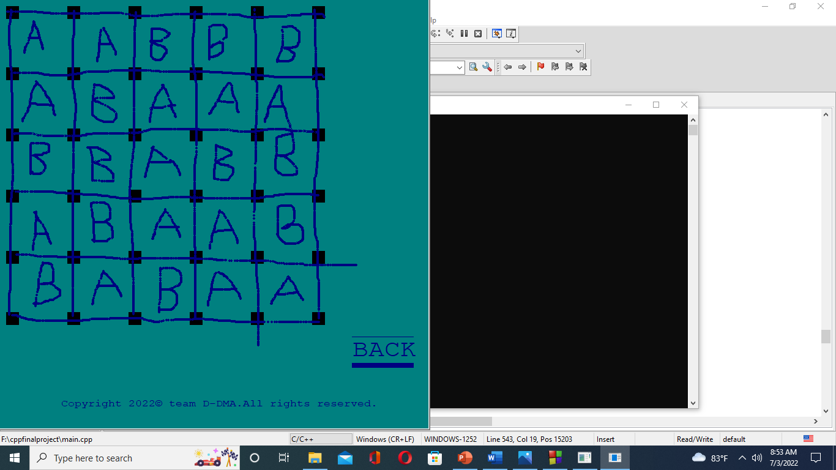
Classic
BLOCK-GAMES
07-2022
24

Slide 25
LITERATURE REVIEW
Digitalization of games like paper pencil game.
Game development using programming.
The tic tac toe game is originally a paper pencil game but we saw that there are so many digital version of that game and that inspires us for this project.
Mainly we are inspired form our childhood days when we used to play this game with friends.
BLOCK-GAMES
25
07-2022

Slide 26
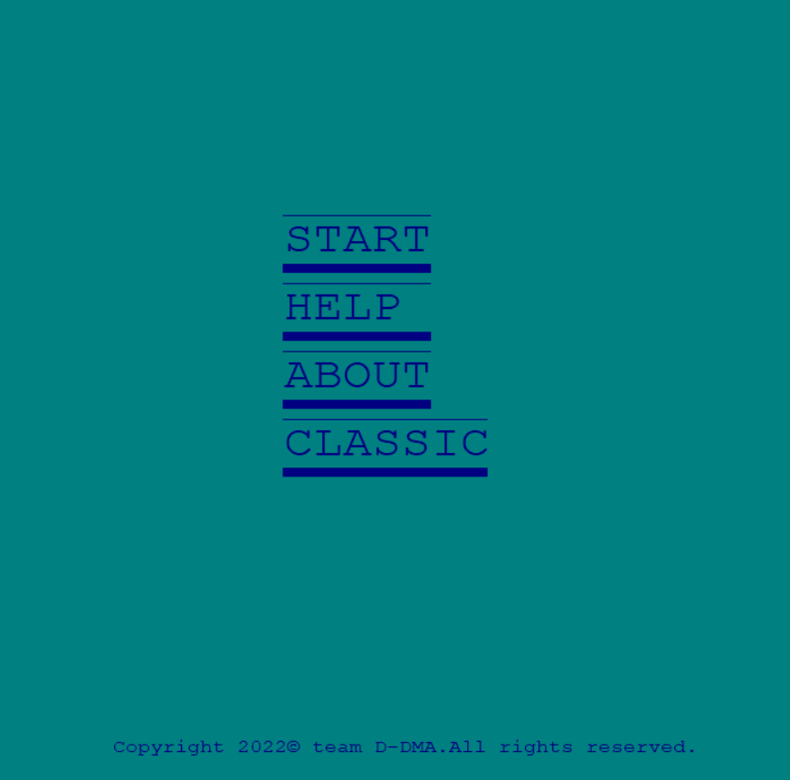
RESULTS
USER INTERFACE
Opens an advanced Board
Provides the help related the game
Provide information about game
Opens a Classic Board
BLOCK-GAMES
07-2022
26

Slide 27
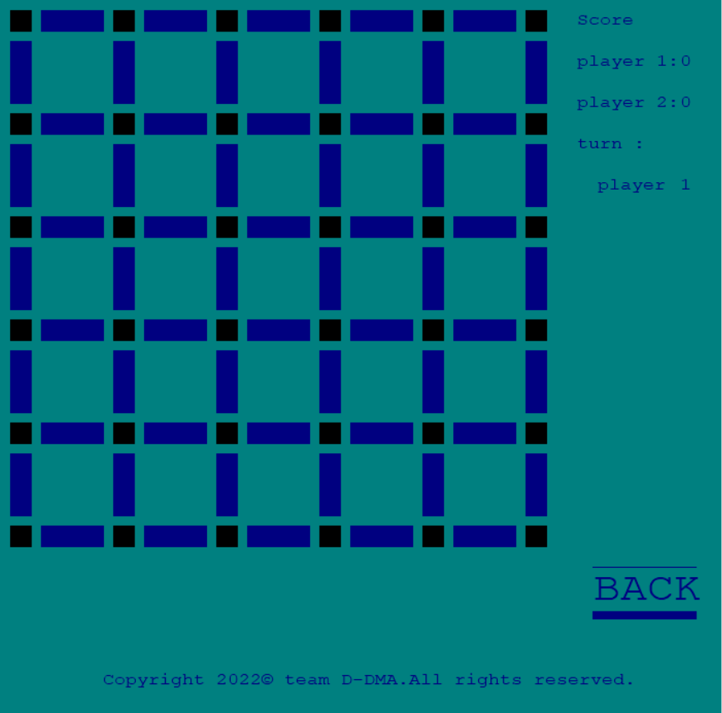
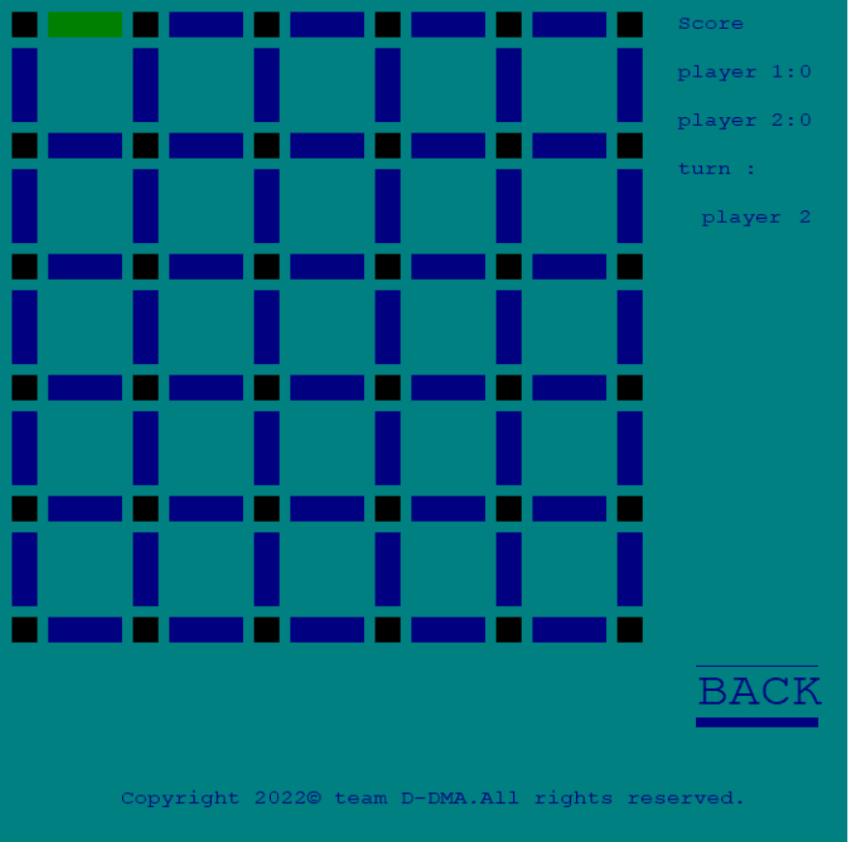
Advanced Board
Score
Board
Takes user to main menu
BLOCK-GAMES
07-2022
27

Slide 28
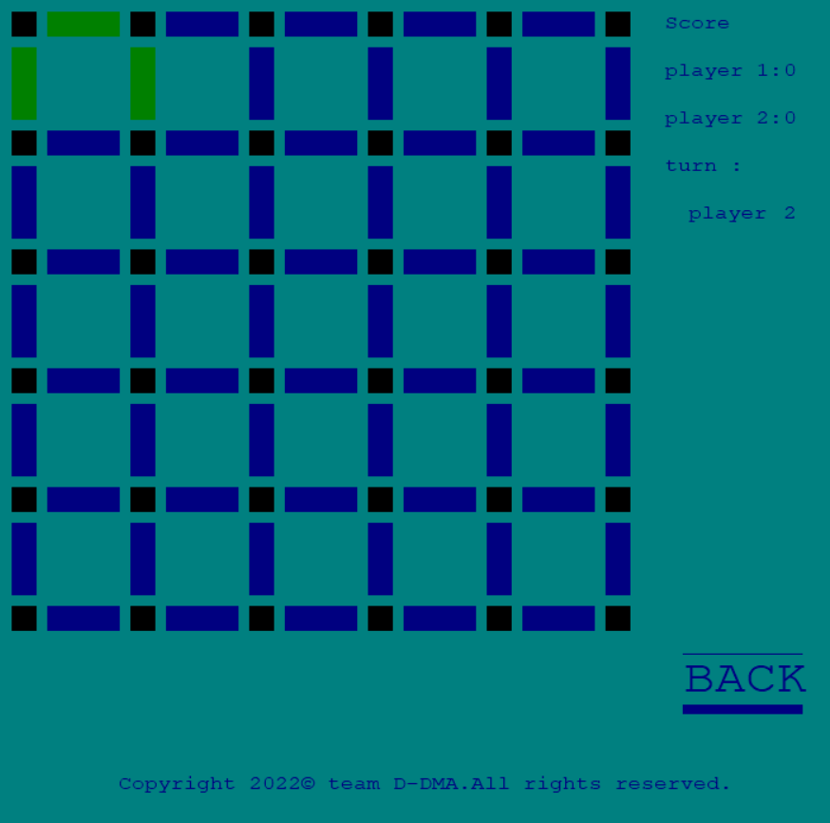
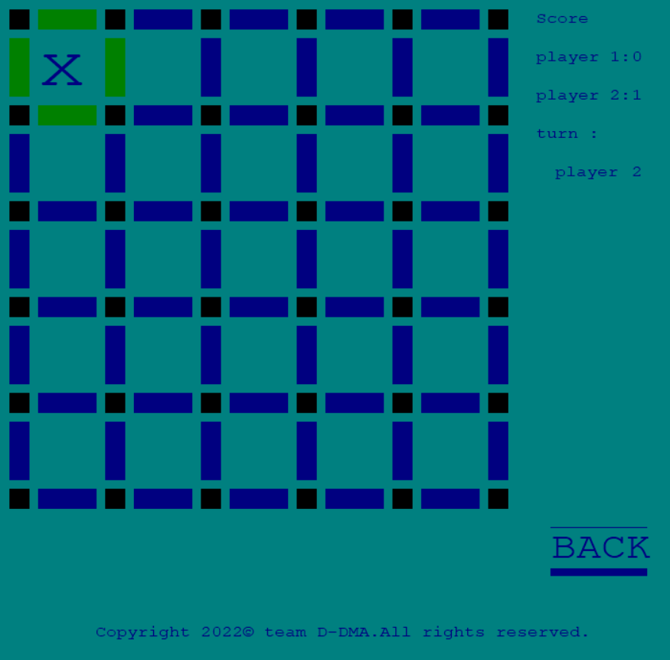
Intermediate game in Advanced Board
Representing Player two completes the block
Green colored sides represents the they are selected
BLOCK-GAMES
07-2022
28

Slide 29
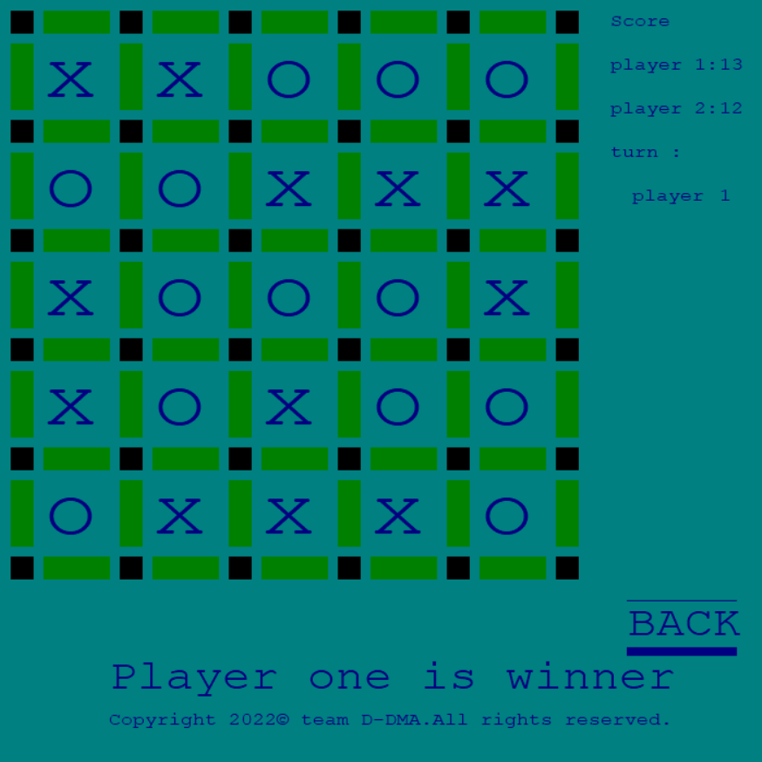
Game ending in Advanced Board
Scores of the both the players
Shows who turn would be next
Or
we can know who finished the agme
Represents player tow completes the block
Represents player one completes the block
Declaration of winner
BLOCK-GAMES
07-2022
29

Slide 30
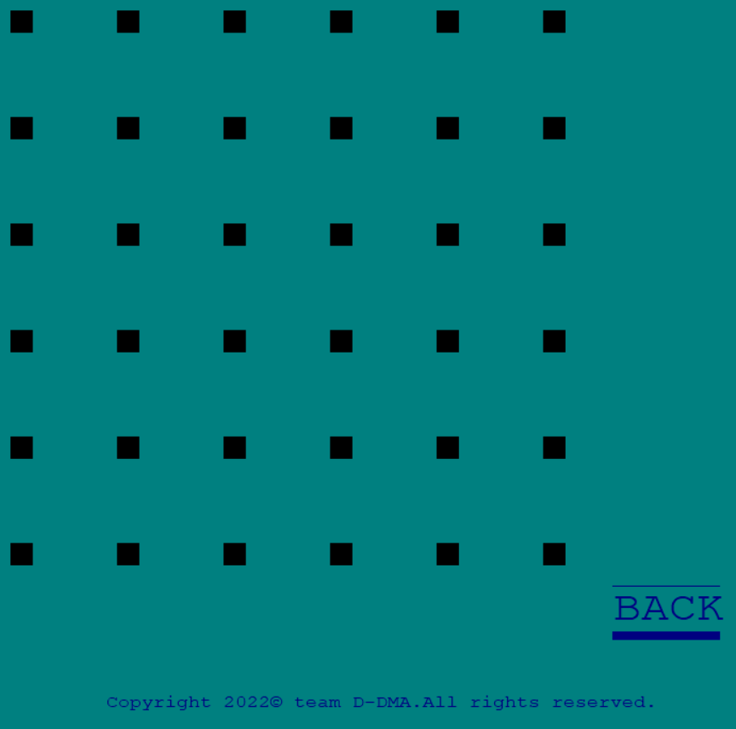

Classic Game
In this board we can draw lines and play the game as in paper . This board provides only dots.
BLOCK-GAMES
07-2022
30

Slide 31

Playing Classic Game board
Symbol of one player and is drawn by players
Symbol of another player and is drawn by players
BLOCK-GAMES
07-2022
31

Slide 32
CONCLUSION
While developing this game we have used the concept of C++ programming language.
For basic logic design we have used loops , control statements and other basics of C++.
Inside that we have used concept of object , class , function , constructor , inheritance(hierarchical) , pointer(this) , array etc.
For file handling we have used fstream.h headerfile , object of ifstream class , opening file using constructor , getline() etc.
BLOCK-GAMES
32
07-2022

Slide 33
REFERENCES
Agrawal, D. (n.d.). setfillstyle() and floodfill() in C. Retrieved from GeeksforGeeks: https://www.geeksforgeeks.org/setfillstyle-floodfill-c/
Dots and Boxes. (n.d.). Retrieved from Wikipedia: https://en.wikipedia.org/wiki/Dots_and_Boxes
Li, S., & Yuan, X. (n.d.). Technique Analysis of Dots-and-Boxes. Retrieved from ResearchGate: https://www.researchgate.net/publication/301454149_Technique_Analysis_of_Dots-and-Boxes
Main, M. (2008, september). Using the WinBGIm Graphics Library with Dev-C++. Retrieved from Colorado: https://home.cs.colorado.edu/~main/bgi/dev-c++/
Prasad, R. (2020, May 1). 01. Introduction to C/C++ graphics.h tutorial series | CodeWar. Retrieved from CodeWar: https://www.youtube.com/watch?v=r7yOMz8HrHk
spielen, K., & puntos, j. c. (2022, February 16). How to Play Dots and Boxes. Retrieved from WikiHow: https://www.wikihow.com/Play-Dots-and-Boxes
BLOCK-GAMES
33
07-2022

Slide 34


